Slide 1

Chapter 10
Symmetric-Key
Cryptography
Copyright © The McGraw-Hill Companies, Inc. Permission required for reproduction or display.
10.<number>

Slide 2
Chapter 10
Objectives
To distinguish between two cryptosystems:
symmetric-key and asymmetric-key
To introduce trapdoor one-way functions and their
use in asymmetric-key cryptosystems
To introduce the knapsack cryptosystem as one of
the first ideas in asymmetric-key cryptography
To discuss the RSA cryptosystem
To discuss the Rabin cryptosystem
To discuss the ElGamal cryptosystem
To discuss the elliptic curve cryptosystem
10.<number>

Slide 3
10-1 INTRODUCTION
Symmetric and asymmetric-key cryptography will exist in parallel and continue to serve the community. We actually believe that they are complements of each other; the advantages of one can compensate for the disadvantages of the other.
Topics discussed in this section:
10.1.1 Keys
10.1.2 General Idea
10.1.3 Need for Both
10.1.4 Trapdoor One-Way Function
10.1.5 Knapsack Cryptosystem
10.<number>

Slide 4

10-1 INTRODUCTION
Symmetric and asymmetric-key cryptography will exist in parallel and continue to serve the community. We actually believe that they are complements of each other; the advantages of one can compensate for the disadvantages of the other.
Note
Symmetric-key cryptography is based on sharing secrecy;
asymmetric-key cryptography is based on personal secrecy.
10.<number>

Slide 5
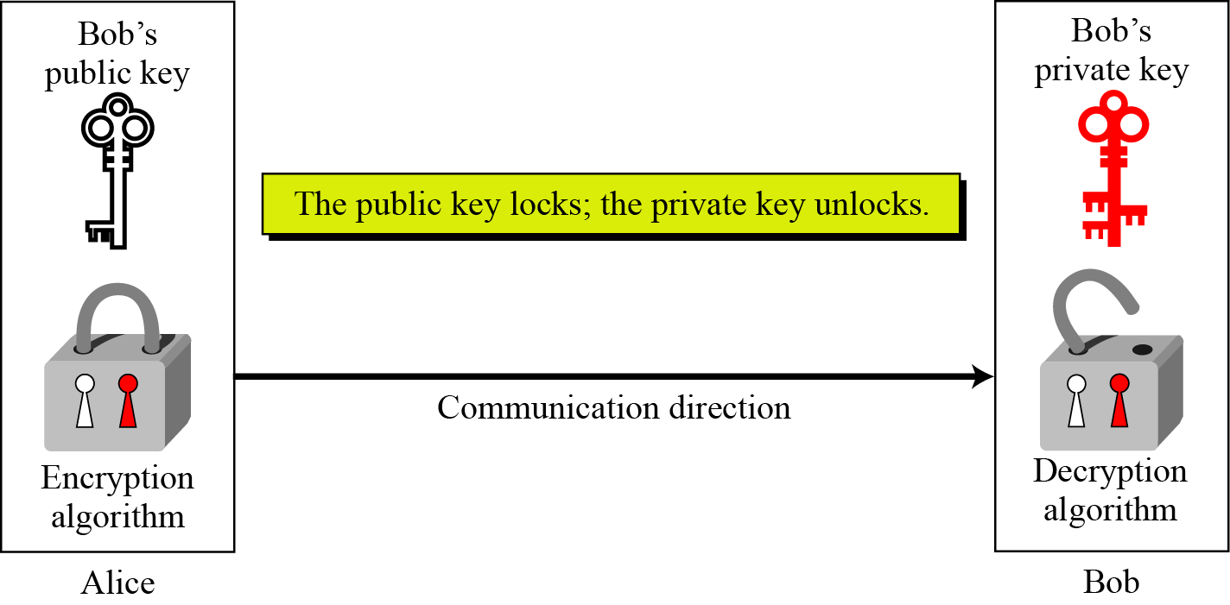
10.1.1 Keys
Asymmetric key cryptography uses two separate keys: one private and one public.
Figure 10.1 Locking and unlocking in asymmetric-key cryptosystem
10.<number>

Slide 6
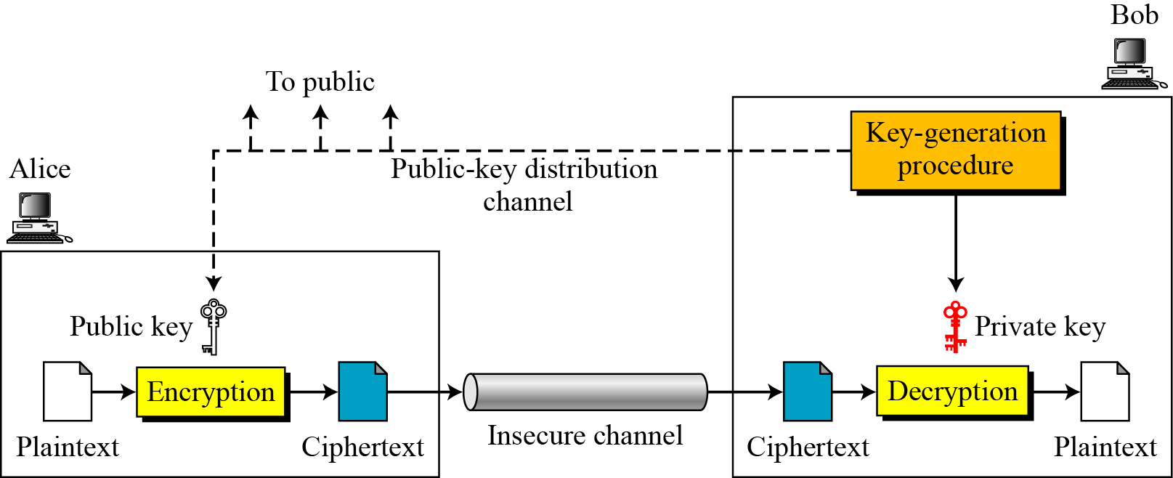
10.1.2 General Idea
Figure 10.2 General idea of asymmetric-key cryptosystem
10.<number>

Slide 7
10.1.2 Continued
Plaintext/Ciphertext
Unlike in symmetric-key cryptography, plaintext and ciphertext are treated as integers in asymmetric-key cryptography.
Encryption/Decryption
C = f (K_{public} , P) P = g(K_{private} , C)
10.<number>

Slide 8
10.1.3 Need for Both
There is a very important fact that is sometimes misunderstood: The advent of asymmetric-key cryptography does not eliminate the need for symmetric-key cryptography.
10.<number>

Slide 9
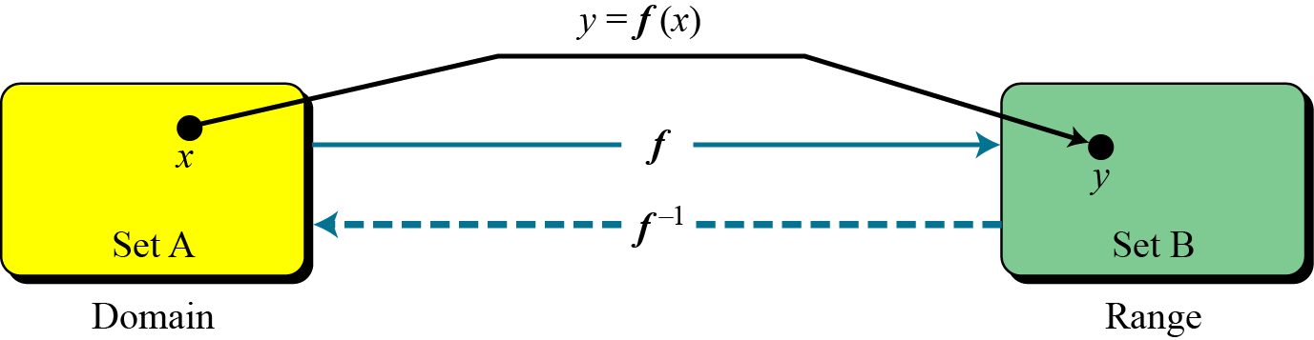
10.1.4 Trapdoor One-Way Function
The main idea behind asymmetric-key cryptography is the concept of the trapdoor one-way function.
Functions
Figure 10.3 A function as rule mapping a domain to a range
10.<number>

Slide 10
10.1.4 Continued
One-Way Function (OWF)
1. f is easy to compute.
2. f ⁻¹ is difficult to compute.
Trapdoor One-Way Function (TOWF)
3. Given y and a trapdoor, x can be
computed easily.
10.<number>

Slide 11
10.1.4 Continued
Example 10. 1
When n is large, n = p × q is a one-way function. Given p and q , it is always easy to calculate n ; given n, it is very difficult to compute p and q. This is the factorization problem.
Example 10. 2
When n is large, the function y = x^{k} mod n is a trapdoor one-way function. Given x, k, and n, it is easy to calculate y. Given y, k, and n, it is very difficult to calculate x. This is the discrete logarithm problem. However, if we know the trapdoor, k′ such that k × k ′ = 1 mod φ(n), we can use x = y^{k′} mod n to find x.
10.<number>

Slide 12
10.1.5 Knapsack Cryptosystem
Definition
a = [a₁, a₂, …, a_{k} ] and x = [x₁, x₂, …, x_{k}].
Given a and x, it is easy to calculate s. However, given s and a it is difficult to find x.
Superincreasing Tuple
a_{i} ≥ a₁ + a₂ + … + a_{i−1}
10.<number>

Slide 13
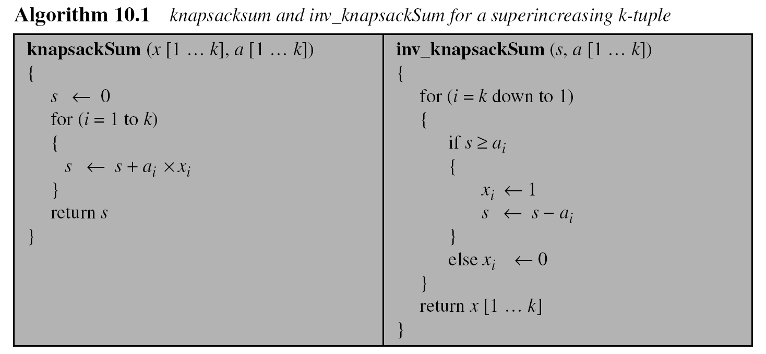
10.1.5 Continued
10.<number>

Slide 14
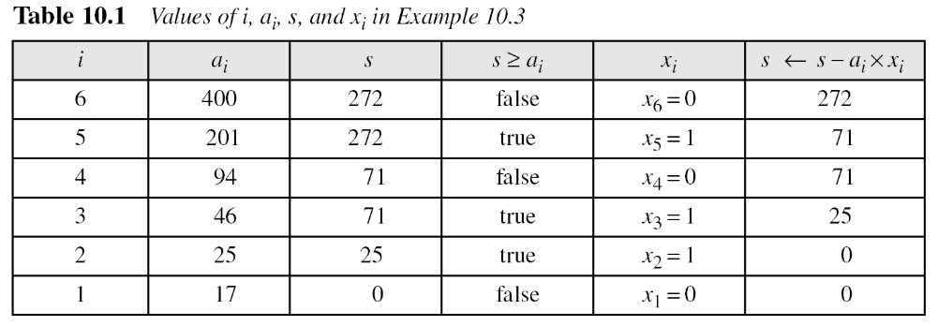
10.1.5 Continued
Example 10. 3
As a very trivial example, assume that a = [17, 25, 46, 94, 201,400] and s = 272 are given. Table 10.1 shows how the tuple x is found using inv_knapsackSum routine in Algorithm 10.1. In this case x = [0, 1, 1, 0, 1, 0], which means that 25, 46, and 201 are in the knapsack.
10.<number>

Slide 15
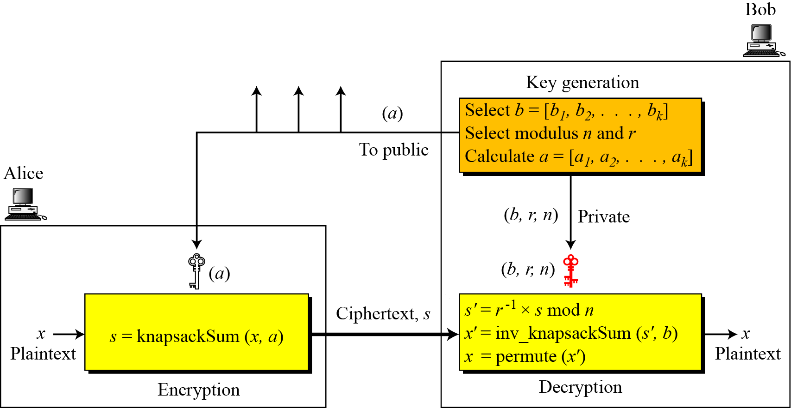
10.1.5 Continued
Secret Communication with Knapsacks.
Figure 10.4 Secret communication with knapsack cryptosystem
10.<number>

Slide 16
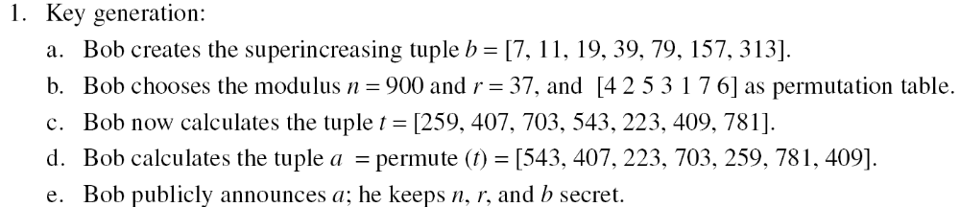
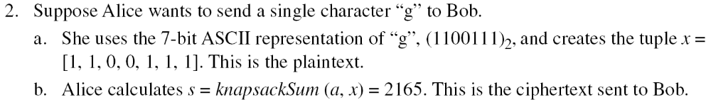
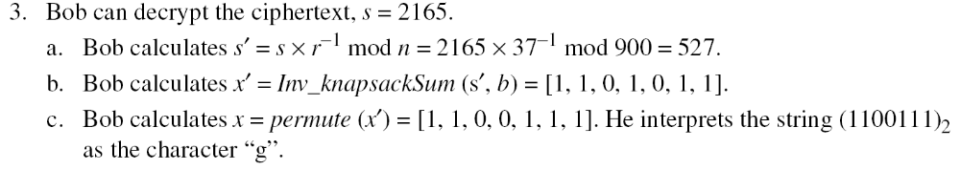
10.1.5 Continued
Example 10. 4
This is a trivial (very insecure) example just to show the procedure.
10.<number>

Slide 17
10-2 RSA CRYPTOSYSTEM
The most common public-key algorithm is the RSA cryptosystem, named for its inventors (Rivest, Shamir, and Adleman).
Topics discussed in this section:
10.2.1 Introduction
10.2.2 Procedure
10.2.3 Some Trivial Examples
10.2.4 Attacks on RSA
10.2.5 Recommendations
10.2.6 Optimal Asymmetric Encryption Padding (OAEP)
10.2.7 Applications
10.<number>

Slide 18
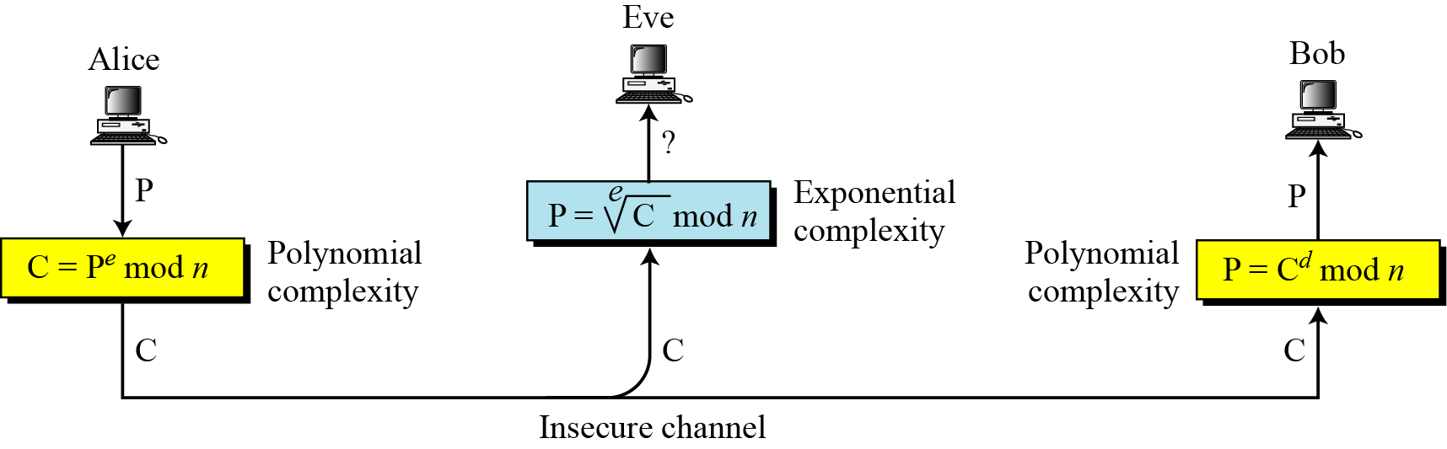
10.2.1 Introduction
Figure 10.5 Complexity of operations in RSA
10.<number>

Slide 19
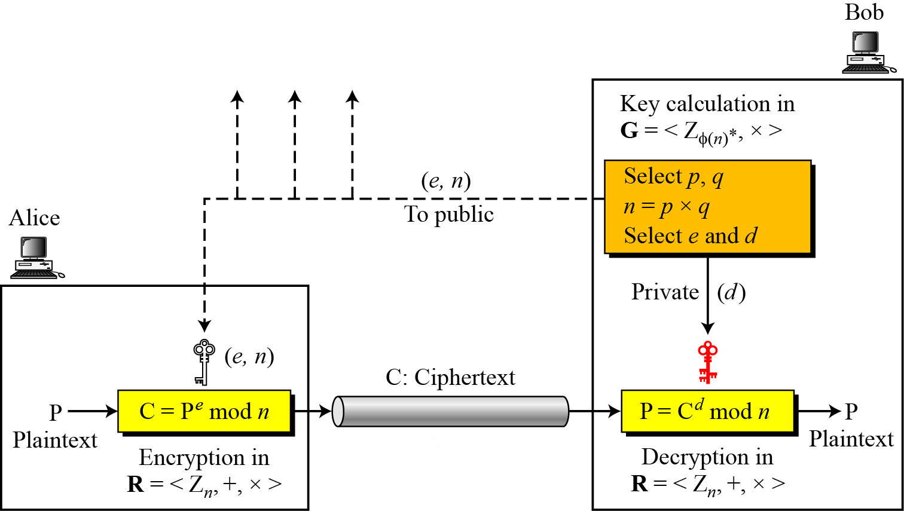
10.2.2 Procedure
Figure 10.6 Encryption, decryption, and key generation in RSA
10.<number>

Slide 20
10.2.2 Continued
Two Algebraic Structures
R = <Z_{n} , +, × >
Encryption/Decryption Ring:
Key-Generation Group:
G = <Z _{φ(n)}∗, × >
10.<number>

Slide 21
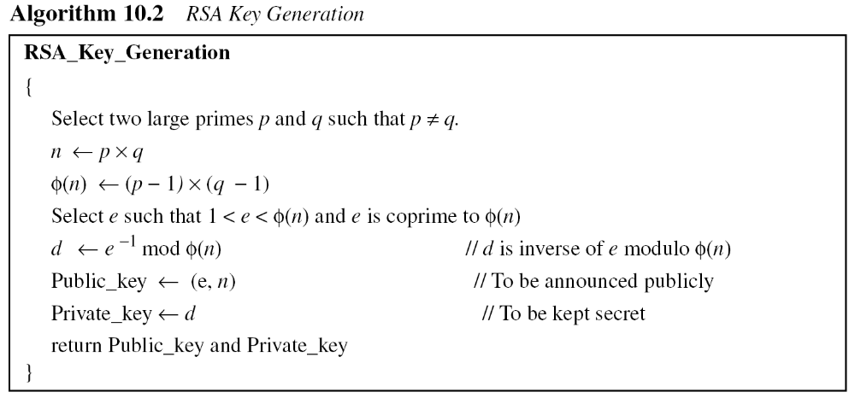
10.2.2 Continued
10.<number>

Slide 22
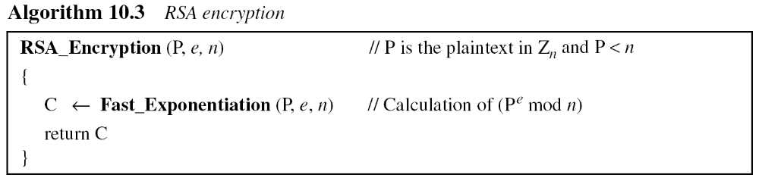
10.2.2 Continued
Encryption
10.<number>

Slide 23
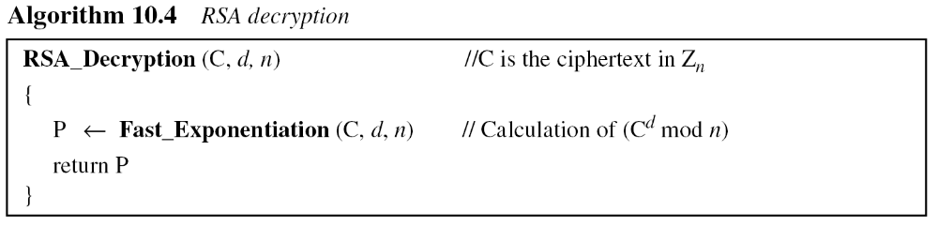
10.2.2 Continued
Decryption
10.<number>

Slide 24
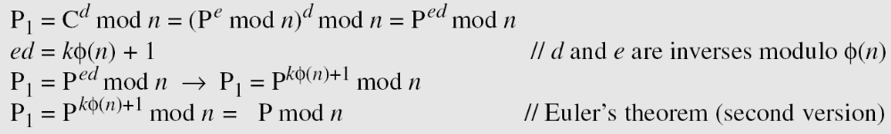
10.2.2 Continued
Proof of RSA
10.<number>

Slide 25
10.2.3 Some Trivial Examples
Example 10. 5
Bob chooses 7 and 11 as p and q and calculates n = 77. The value of φ(n) = (7 − 1)(11 − 1) or 60. Now he chooses two exponents, e and d, from Z₆₀∗. If he chooses e to be 13, then d is 37. Note that e × d mod 60 = 1 (they are inverses of each Now imagine that Alice wants to send the plaintext 5 to Bob. She uses the public exponent 13 to encrypt 5.
Bob receives the ciphertext 26 and uses the private key 37 to decipher the ciphertext:
10.<number>

Slide 26
10.2.3 Some Trivial Examples
Example 10. 6
Now assume that another person, John, wants to send a message to Bob. John can use the same public key announced by Bob (probably on his website), 13; John’s plaintext is 63. John calculates the following:
Bob receives the ciphertext 28 and uses his private key 37 to decipher the ciphertext:
10.<number>

Slide 27
10.2.3 Some Trivial Examples
Example 10. 7
Jennifer creates a pair of keys for herself. She chooses p = 397 and q = 401. She calculates
n = 159197. She then calculates φ(n) = 158400. She then chooses e = 343 and d = 12007. Show how Ted can send a message to Jennifer if he knows e and n.
Suppose Ted wants to send the message “NO” to Jennifer. He changes each character to a number (from 00 to 25), with each character coded as two digits. He then concatenates the two coded characters and gets a four-digit number. The plaintext is 1314. Figure 10.7 shows the process.
10.<number>

Slide 28
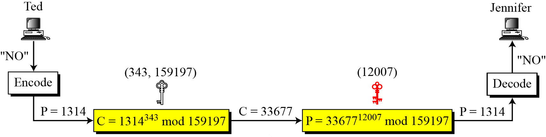
10.2.3 Continued
Figure 10.7 Encryption and decryption in Example 10.7
10.<number>

Slide 29
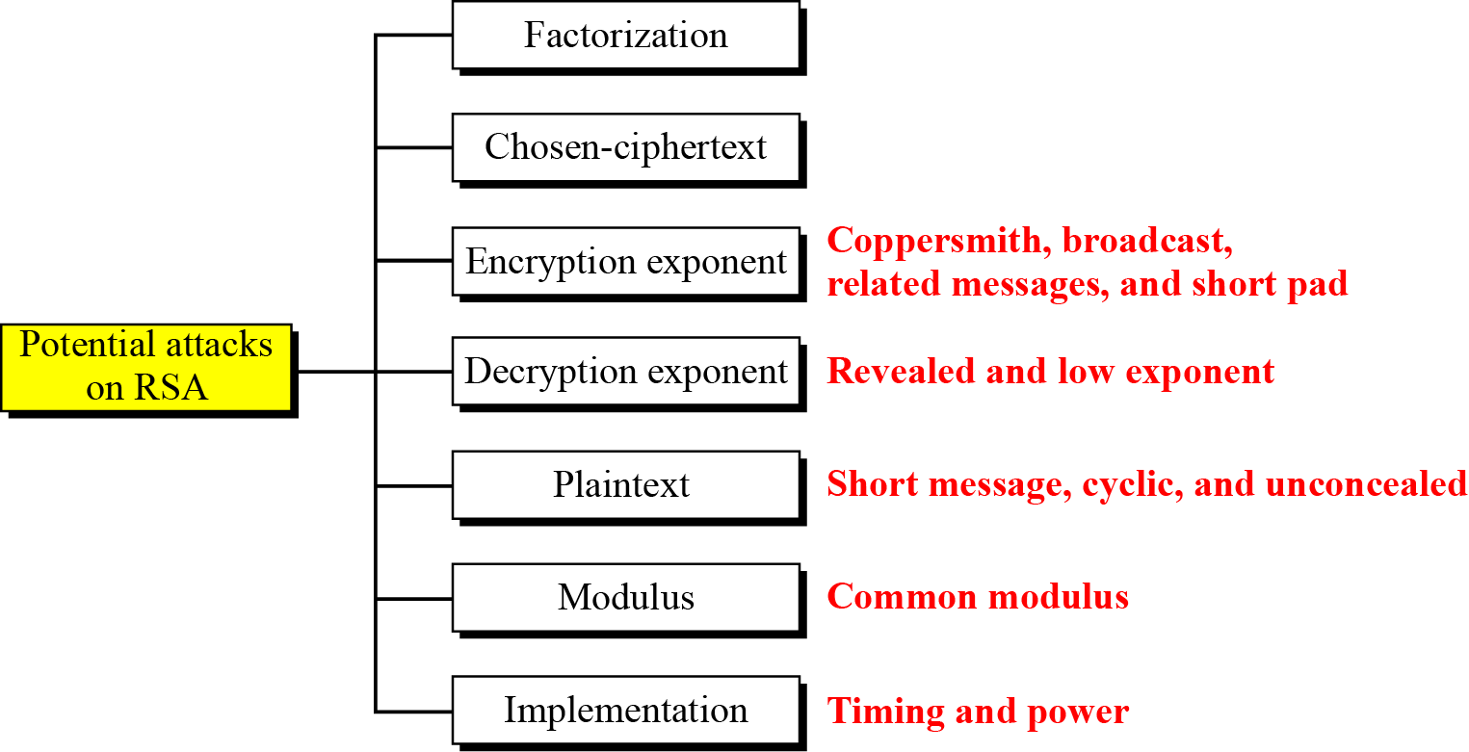
10.2.4 Attacks on RSA
Figure 10.8 Taxonomy of potential attacks on RSA
10.<number>

Slide 30
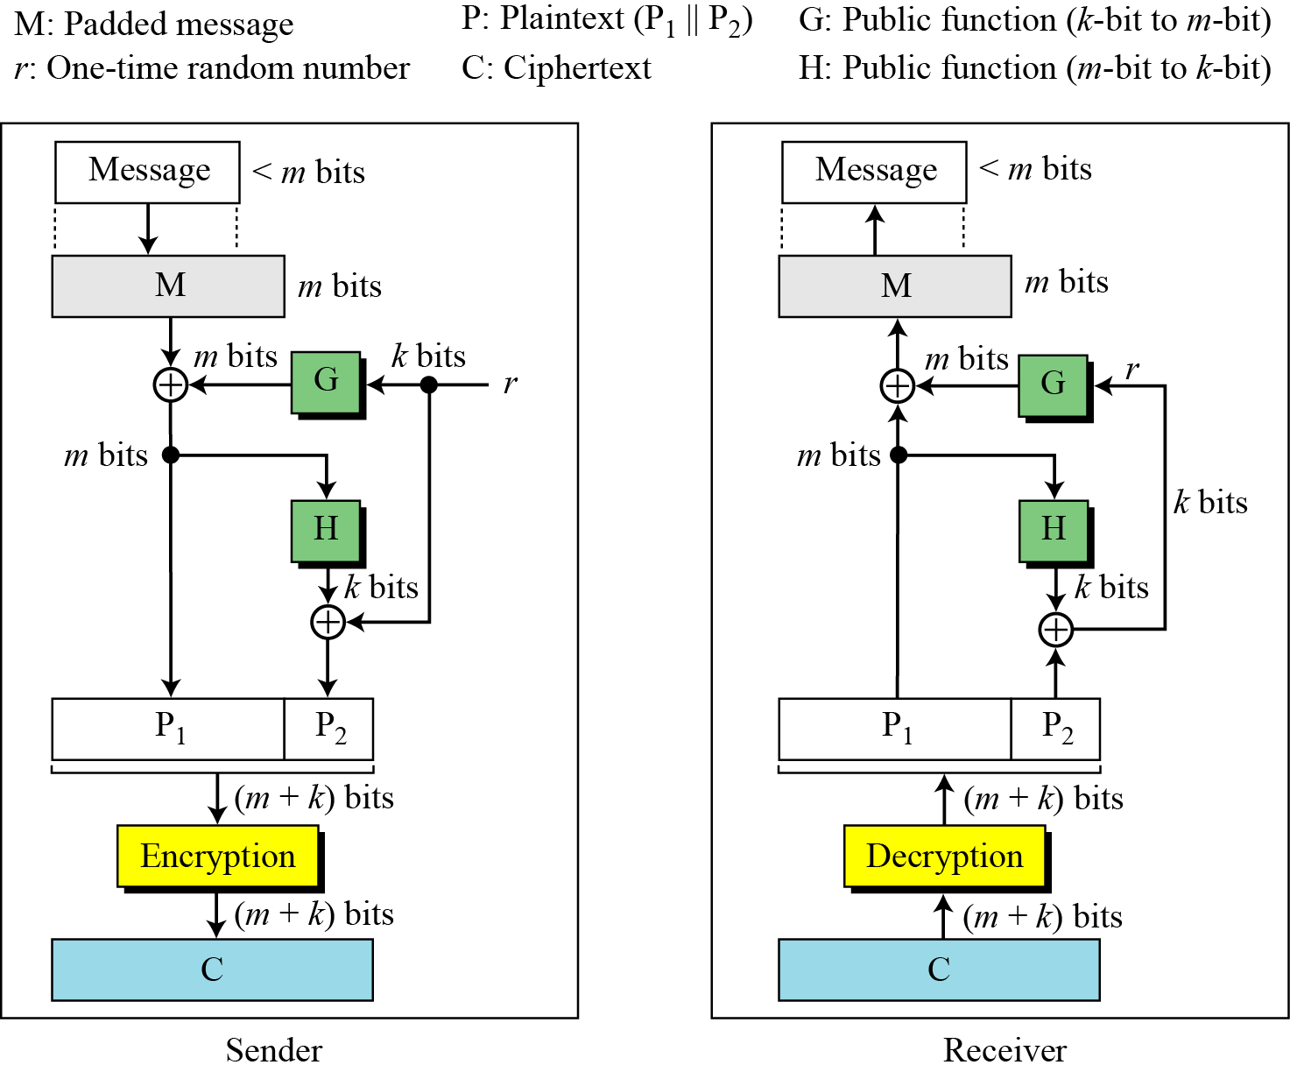
10.2.6 OAEP
Figure 10.9 Optimal asymmetric encryption padding (OAEP)
10.<number>

Slide 31
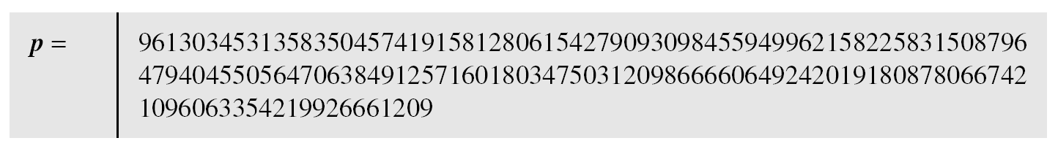
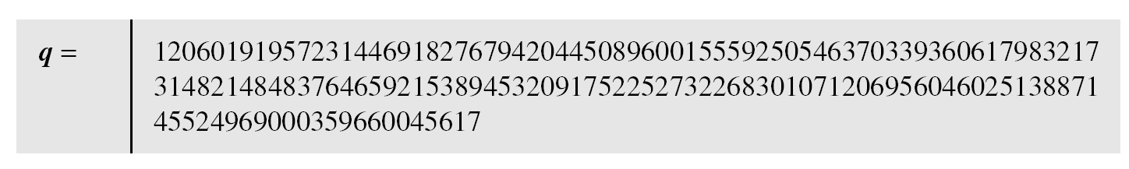
10.2.6 Continued
Example 10. 8
Here is a more realistic example. We choose a 512-bit p and q, calculate n and φ(n), then choose e and test for relative primeness with φ(n). We then calculate d. Finally, we show the results of encryption and decryption. The integer p is a 159-digit number.
10.<number>

Slide 32
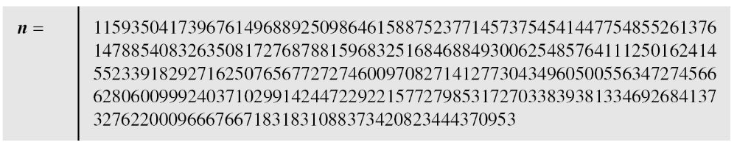
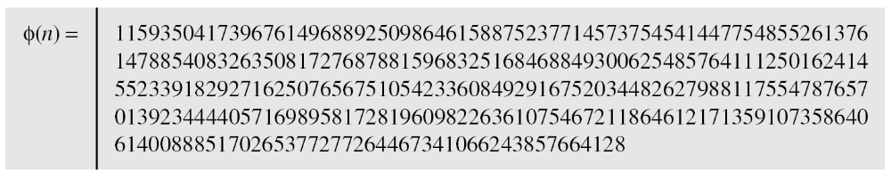
10.2.6 Continued
Example 10. 8
Continued
The modulus n = p × q. It has 309 digits.
φ(n) = (p − 1)(q − 1) has 309 digits.
10.<number>

Slide 33
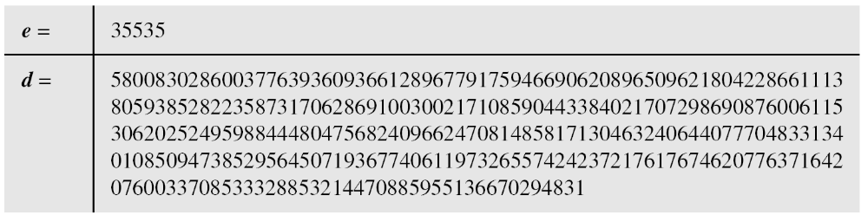
10.2.6 Continued
Example 10. 8
Continued
Bob chooses e = 35535 (the ideal is 65537) and tests it to make sure it is relatively prime with φ(n). He then finds the inverse of e modulo φ(n) and calls it d.
10.<number>

Slide 34
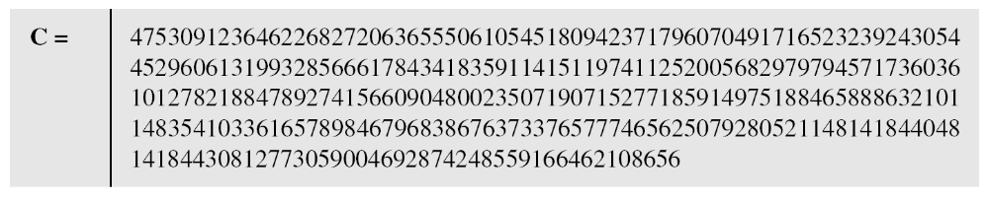
10.2.6 Continued
Example 10. 8
Continued
Alice wants to send the message “THIS IS A TEST”, which can be changed to a numeric value using the 00−26 encoding scheme (26 is the space character).
The ciphertext calculated by Alice is C = P^{e}, which is
10.<number>

Slide 35
10.2.6 Continued
Example 10. 8
Continued
Bob can recover the plaintext from the ciphertext using P = C^{d}, which is
The recovered plaintext is “THIS IS A TEST” after decoding.
10.<number>

Slide 36
10-3 RABIN CRYPTOSYSTEM
The Rabin cryptosystem can be thought of as an RSA cryptosystem in which the value of e and d are fixed. The encryption is C ≡ P² (mod n) and the decryption is P ≡ C^{1/2} (mod n).
Topics discussed in this section:
10.3.1 Procedure
10.3.2 Security of the Rabin System
10.<number>

Slide 37
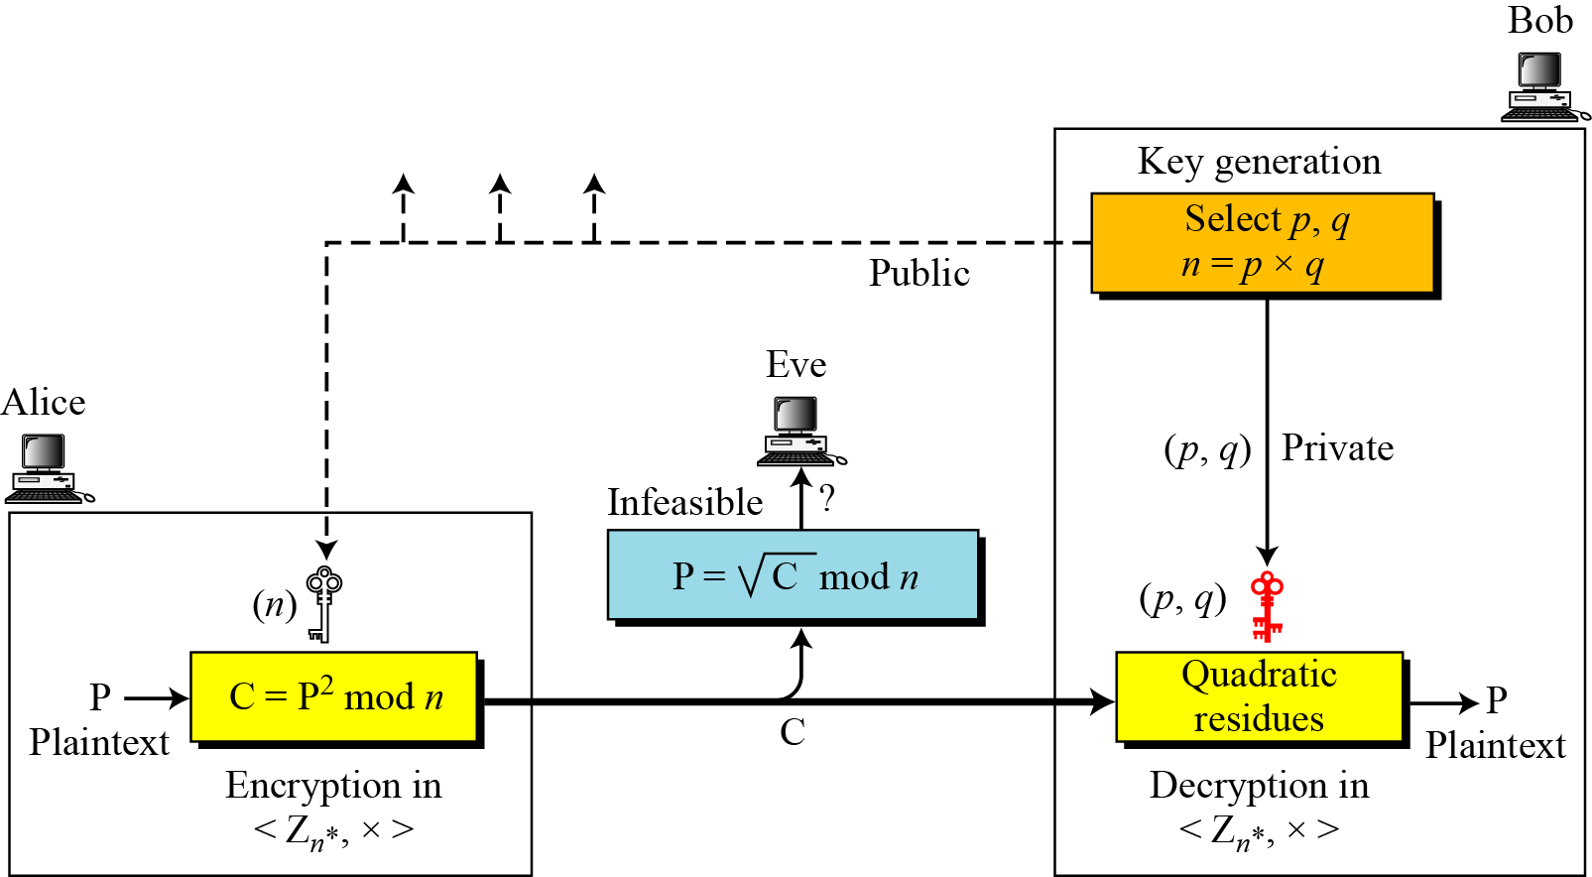
10-3 Continued
Figure 10.10 Rabin cryptosystem
10.<number>

Slide 38
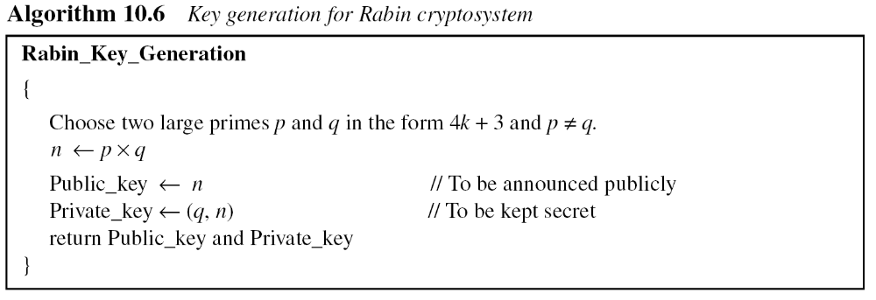
10.3.1 Procedure
Key Generation
10.<number>

Slide 39
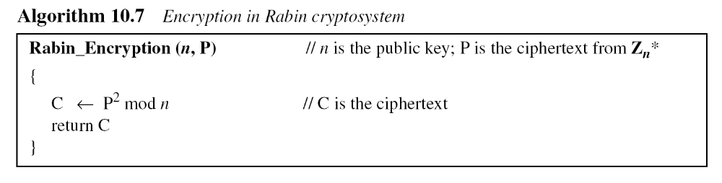
10.3.1 Continued
Encryption
10.<number>

Slide 40
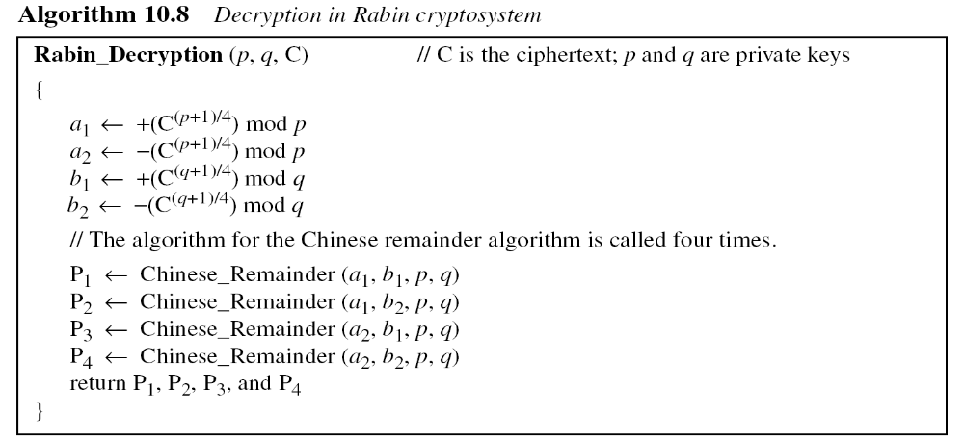
10.3.1 Continued
Decryption
Note
The Rabin cryptosystem is not deterministic: Decryption creates four plaintexts.
10.<number>

Slide 41
10.3.1 Continued
Example 10. 9
Here is a very trivial example to show the idea.
Bob selects p = 23 and q = 7. Note that both are
congruent to 3 mod 4.
Bob calculates n = p × q = 161.
Bob announces n publicly; he keeps p and q private.
Alice wants to send the plaintext P = 24. Note that 161 and 24 are relatively prime; 24 is in Z₁₆₁*. She calculates C = 24² = 93 mod 161, and sends the ciphertext 93 to Bob.
10.<number>

Slide 42
10.3.1 Continued
Example 10. 9
Bob receives 93 and calculates four values:
a₁ = +(93 ^{(23+1)/4}) mod 23 = 1 mod 23
a₂ = −(93 ^{(23+1)/4}) mod 23 = 22 mod 23
b₁ = +(93 ^{(7+1)/4}) mod 7 = 4 mod 7
b₂ = −(93 ^{(7+1)/4}) mod 7 = 3 mod 7
Bob takes four possible answers, (a₁, b₁), (a₁, b₂), (a₂, b₁), and (a₂, b₂), and uses the Chinese remainder theorem to find four possible plaintexts: 116, 24, 137, and 45. Note that only the second answer is Alice’s plaintext.
10.<number>

Slide 43
10-4 ELGAMAL CRYPTOSYSTEM
Besides RSA and Rabin, another public-key cryptosystem is ElGamal. ElGamal is based on the discrete logarithm problem discussed in Chapter 9.
Topics discussed in this section:
10.4.1 ElGamal Cryptosystem
10.4.2 Procedure
10.4.3 Proof
10.4.4 Analysis
10.4.5 Security of ElGamal
10.4.6 Application
10.<number>

Slide 44
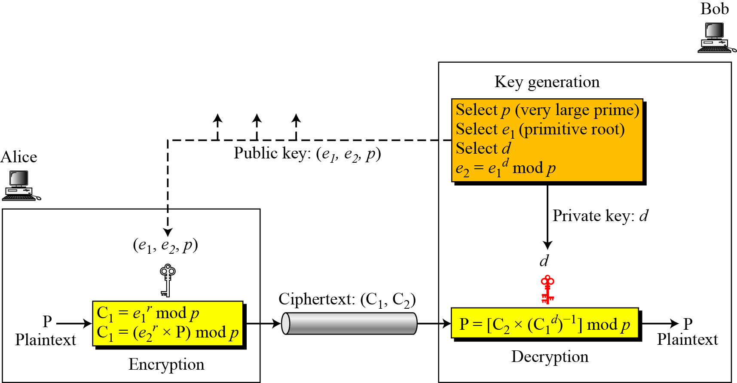
10.4.2 Procedure
Figure 10.11 Key generation, encryption, and decryption in ElGamal
10.<number>

Slide 45
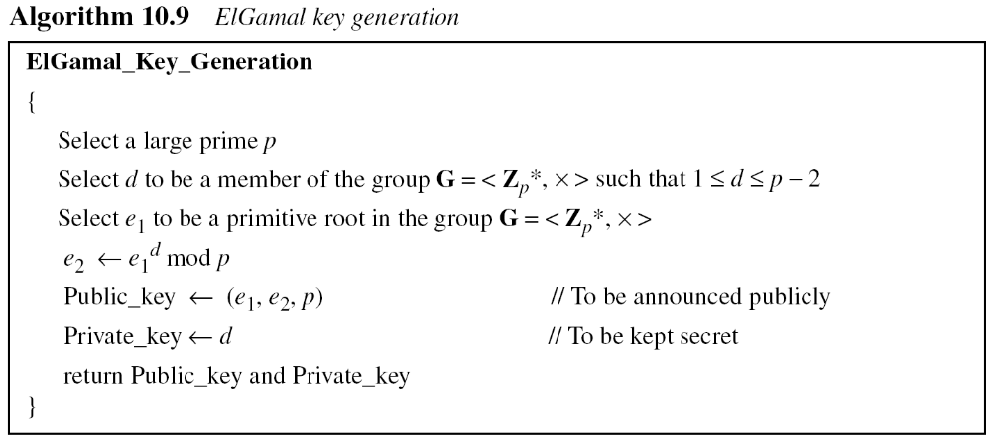
10.4.2 Continued
Key Generation
10.<number>

Slide 46
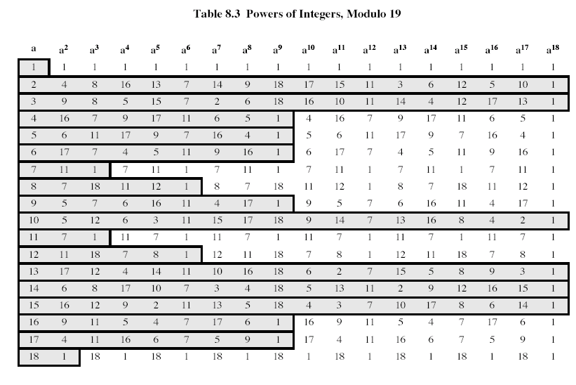

Slide 47
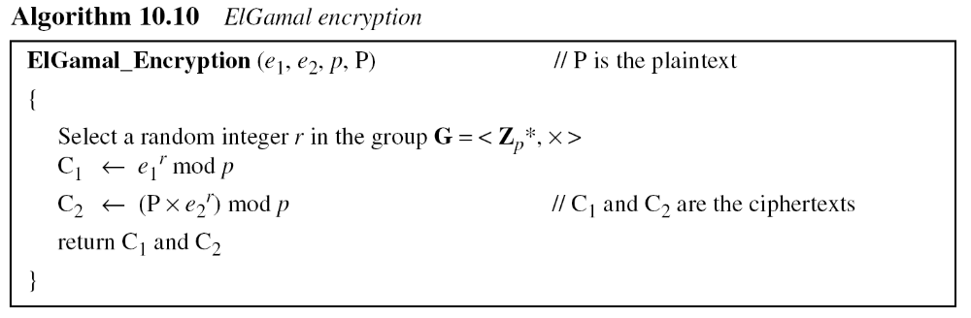
10.4.2 Continued
10.<number>

Slide 48
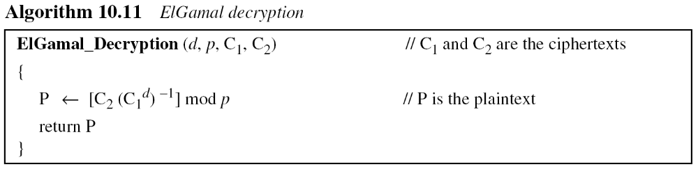
10.4.2 Continued
Note
The bit-operation complexity of encryption or decryption in ElGamal cryptosystem is polynomial.
10.<number>

Slide 49
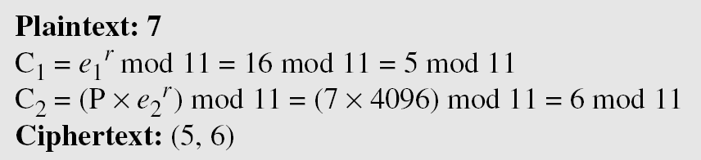
10.4.3 Continued
Example 10. 10
Here is a trivial example. Bob chooses p = 11 and e₁ = 2.
and d = 3 e₂ = e₁^{d} = 8. So the public keys are (2, 8, 11) and the private key is 3. Alice chooses r = 4 and calculates C1 and C2 for the plaintext 7.
Bob receives the ciphertexts (5 and 6) and calculates the plaintext.
10.<number>

Slide 50
10.4.3 Continued
Example 10. 11
Instead of using P = [C₂ × (C₁^{d}) ⁻¹] mod p for decryption, we can avoid the calculation of multiplicative inverse and use
P = [C₂ × C₁ ^{p−1−d}] mod p (see Fermat’s little theorem in Chapter 9). In Example 10.10, we can calculate P = [6 × 5 ¹¹⁻¹⁻³] mod 11
= 7 mod 11.
Note
For the ElGamal cryptosystem, p must be at least 300 digits and r must be new for each encipherment.
10.<number>

Slide 51
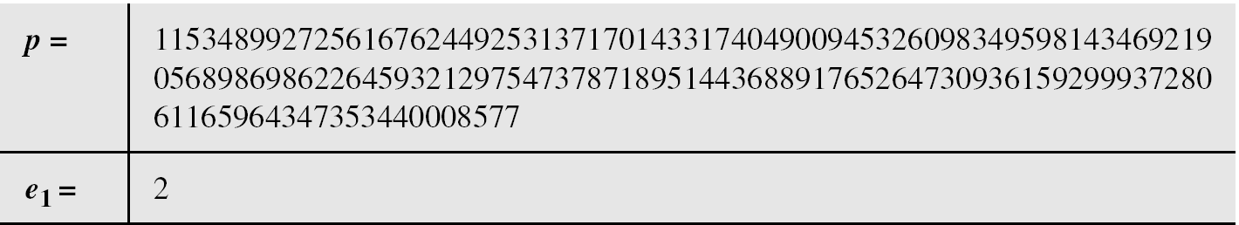
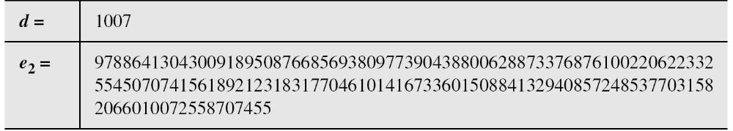
10.4.3 Continued
Example 10. 12
Bob uses a random integer of 512 bits. The integer p is a 155-digit number (the ideal is 300 digits). Bob then chooses e₁, d, and calculates e₂, as shown below:
10.<number>

Slide 52
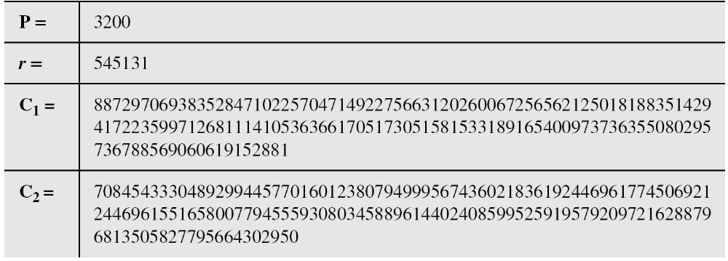
10.4.3 Continued
Example 10. 10
Alice has the plaintext P = 3200 to send to Bob. She chooses
r = 545131, calculates C1 and C2, and sends them to Bob.
Bob calculates the plaintext P = C₂ × ((C₁)^{d})⁻¹ mod p = 3200 mod p.
10.<number>

Slide 53
10-5 ELLIPTIC CURVE CRYPTOSYSTEMS
Although RSA and ElGamal are secure asymmetric-key cryptosystems, their security comes with a price, their large keys. Researchers have looked for alternatives that give the same level of security with smaller key sizes. One of these promising alternatives is the elliptic curve cryptosystem (ECC).
Topics discussed in this section:
10.5.1 Elliptic Curves over Real Numbers
10.5.2 Elliptic Curves over GF( p)
10.5.3 Elliptic Curves over GF(2^{n})
10.5.4 Elliptic Curve Cryptography Simulating ElGamal
10.<number>

Slide 54
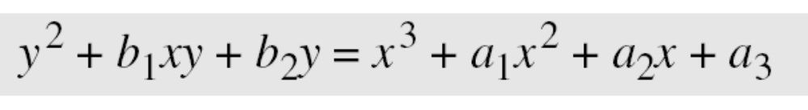
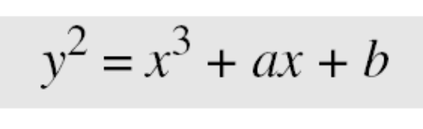
10.5.1 Elliptic Curves over Real Numbers
The general equation for an elliptic curve is
Elliptic curves over real numbers use a special class of elliptic curves of the form
10.<number>

Slide 55
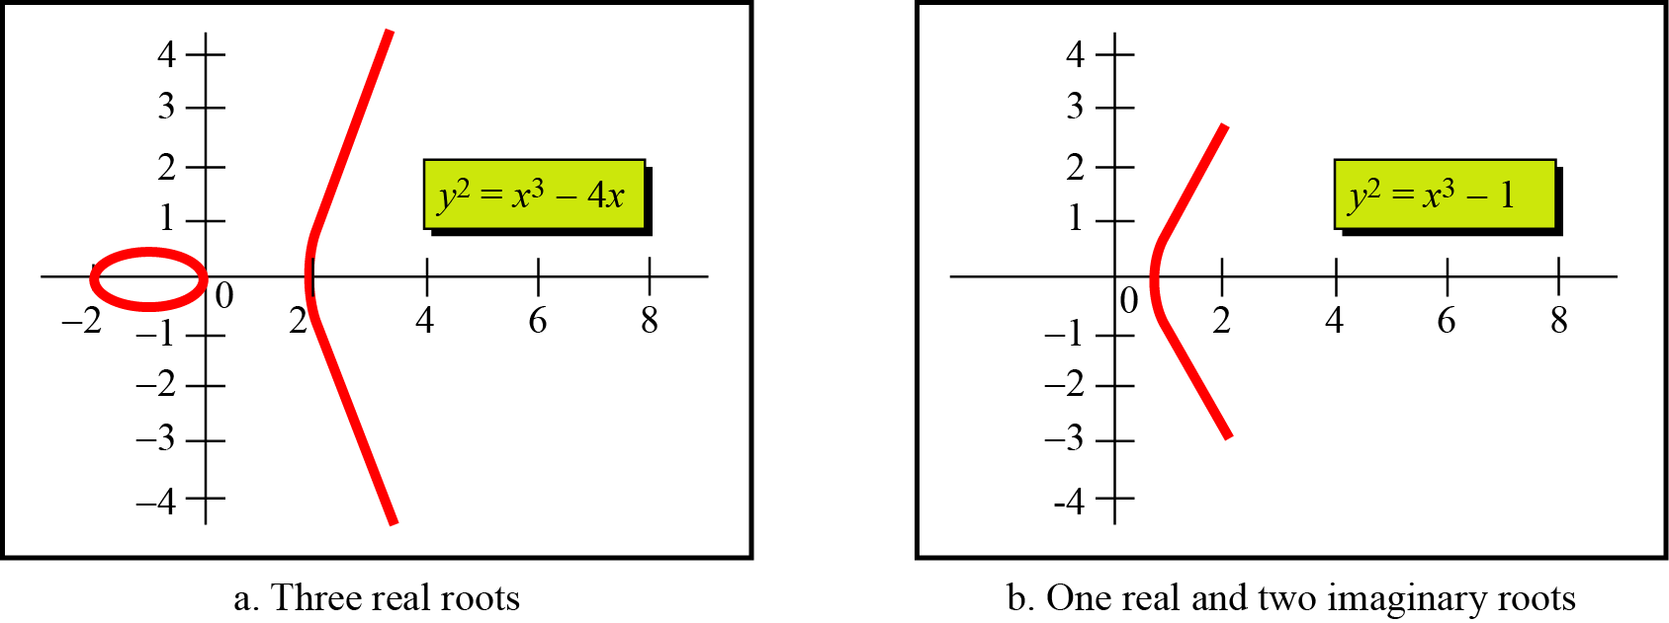
Example 10. 13
Figure 10.12 shows two elliptic curves with equations y² = x³ − 4x and y² = x³ − 1. Both are nonsingular. However, the first has three real roots (x = −2, x = 0, and x = 2), but the second has only one real root (x = 1) and two imaginary ones.
Figure 10.12 Two elliptic curves over a real field
10.<number>

Slide 56
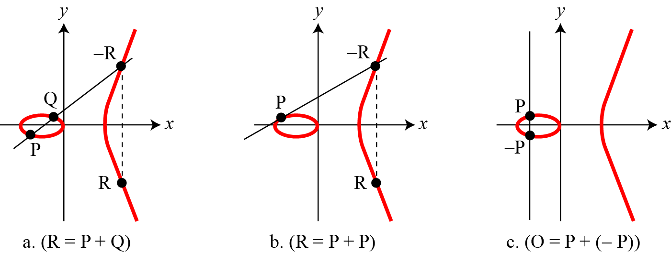
10.5.1 Continued
Figure 10.13 Three adding cases in an elliptic curve
10.<number>

Slide 57
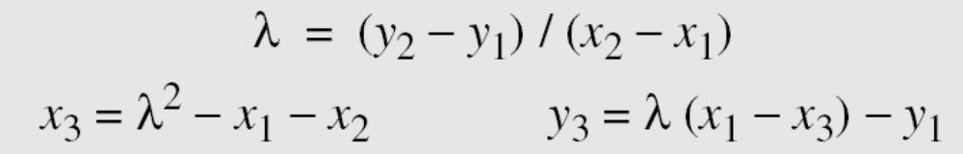
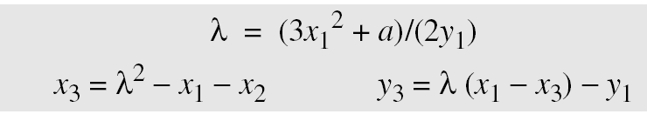
10.5.1 Continued
1.
2.
3. The intercepting point is at infinity; a point O as the point at infinity or zero point, which is the additive identity of the group.
10.<number>

Slide 58
10.5.2 Elliptic Curves over GF( p)
Finding an Inverse
The inverse of a point (x, y) is (x, −y), where −y is the additive inverse of y. For example, if p = 13, the inverse of (4, 2) is (4, 11).
Finding Points on the Curve
Algorithm 10.12 shows the pseudocode for finding the points on the curve Ep(a, b).
10.<number>

Slide 59
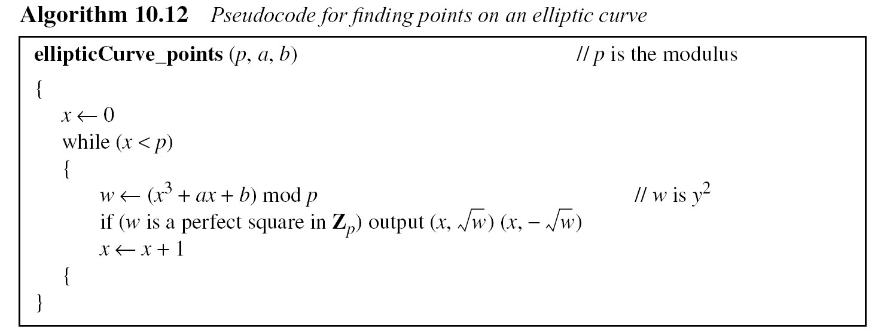
10.5.2 Continued
10.<number>

Slide 60
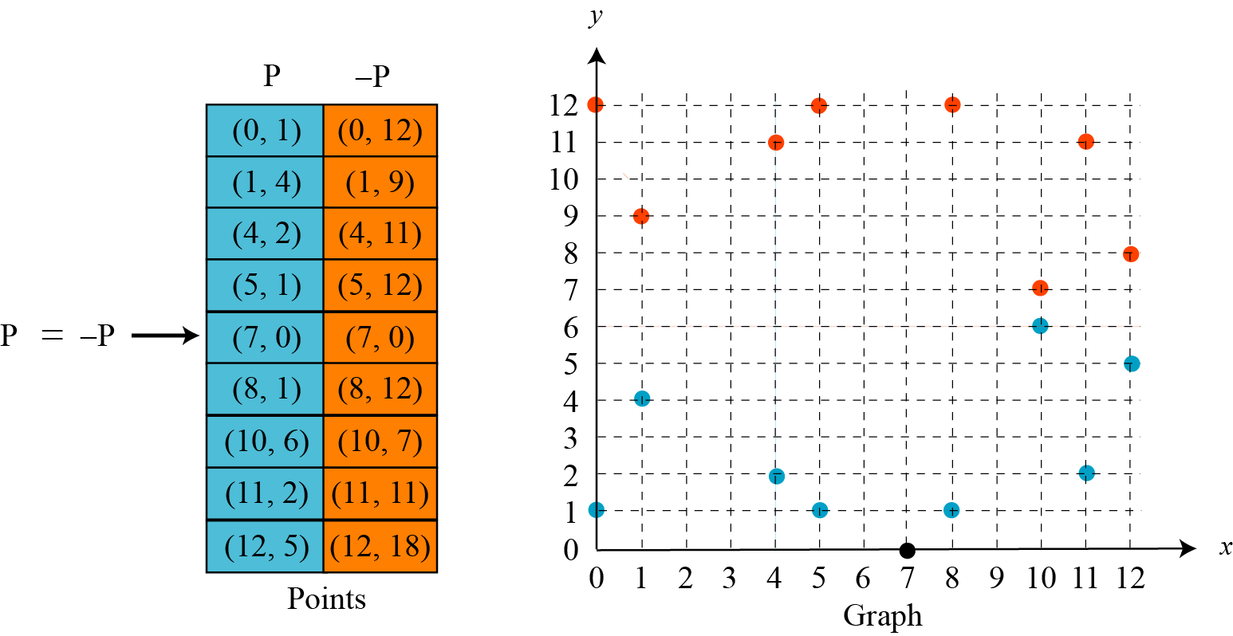
Example 10. 14
The equation is y² = x³ + x + 1 and the calculation is done modulo 13.
Figure 10.14 Points on an elliptic curve over GF(p)
10.<number>

Slide 61
10.5.2 Continued
Example 10. 15
Let us add two points in Example 10.14, R = P + Q, where
P = (4, 2) and Q = (10, 6).
a. λ = (6 − 2) × (10 − 4)⁻¹ mod 13 = 4 × 6⁻¹ mod 13 = 5 mod 13.
b. x = (5² − 4 −10) mod 13 = 11 mod 13.
c. y = [5 (4 −11) − 2] mod 13 = 2 mod 13.
d. R = (11, 2), which is a point on the curve in Example 10.14.
How about E₂₃(1,1), let P=(3, 10) and Q=(9,7)
P + Q?
2P?
10.<number>

Slide 62
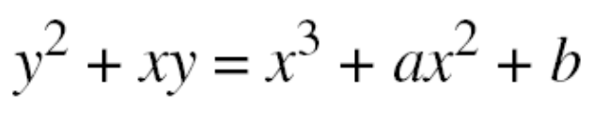
10.5.3 Elliptic Curves over GF(2^{n})
To define an elliptic curve over GF(2^{n}), one needs to change the cubic equation. The common equation is
Finding Inverses
If P = (x, y), then −P = (x, x + y).
Finding Points on the Curve
We can write an algorithm to find the points on the curve using generators for polynomials discussed in Chapter 7..
10.<number>

Slide 63
10.5.3 Continued
Finding Inverses
If P = (x, y), then −P = (x, x + y).
Finding Points on the Curve
We can write an algorithm to find the points on the curve using generators for polynomials discussed in Chapter 7. This algorithm is left as an exercise. Following is a very
trivial example.
10.<number>

Slide 64
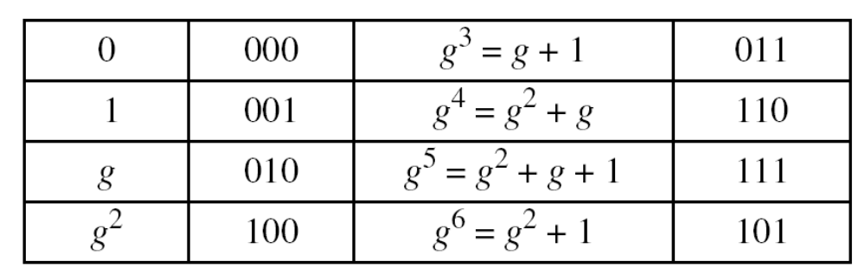
10.5.3 Continued
Example 10. 16
We choose GF(2³) with elements {0, 1, g, g², g³, g⁴, g⁵, g⁶} using the irreducible polynomial of f(x) = x³ + x + 1, which means that
g³ + g + 1 = 0 or g³ = g + 1. Other powers of g can be calculated
accordingly. The following shows the values of the g’s.
10.<number>

Slide 65
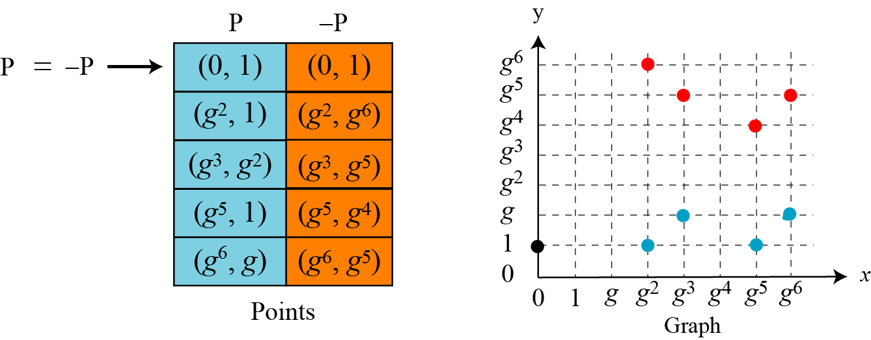
10.5.3 Continued
Example 10. 16
Continued
Using the elliptic curve y² + xy = x³ + g³x² + 1, with a = g³ and
b = 1, we can find the points on this curve, as shown in Figure 10.15..
Figure 10.15 Points on an elliptic curve over GF(2n)
10.<number>

Slide 66
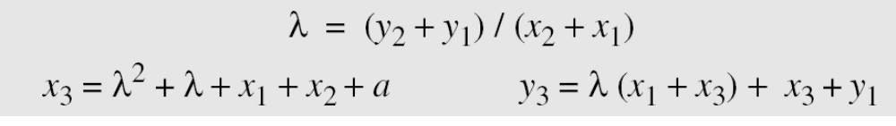
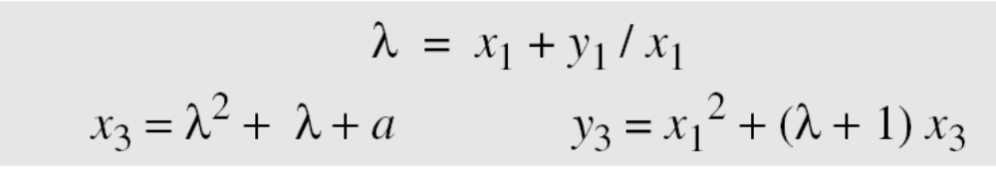
10.5.3 Continued
Adding Two Points
1. If P = (x₁, y₁), Q = (x₂, y₂), Q ≠ −P, and Q ≠ P, then R = (x₃, y₃)
= P + Q can be found as
If Q = P, then R = P + P (or R = 2P) can be found as
10.<number>

Slide 67
10.5.3 Continued
Example 10. 17
Let us find R = P + Q, where P = (0, 1) and Q = (g², 1).
We have λ = 0 and R = (g⁵, g⁴).
Example 10. 18
Let us find R = 2P, where P = (g², 1). We have λ = g² + 1/g²
= g² + g⁵ = g + 1 and R = (g⁶, g⁵).
10.<number>

Slide 68

10.5.4 ECC Simulating ElGamal
Figure 10.16 ElGamal cryptosystem using the elliptic curve
10.<number>

Slide 69

10.5.4 Continued
Generating Public and Private Keys
E(a, b) e₁(x₁, y₁) d e₂(x₂, y₂) = d × e₁(x₁, y₁)
Encryption
Decryption
Note
The security of ECC depends on the difficulty of solving the elliptic curve logarithm problem.
10.<number>

Slide 70
10.5.4 Continued
Example 10. 19
Bob selects E₆₇(2, 3) as the elliptic curve over GF(p).
Bob selects e₁ = (2, 22) and d = 4.
Bob calculates e₂ = (13, 45), where e₂ = d × e₁.
Bob publicly announces the tuple (E, e₁, e₂).
Alice sends the plaintext P = (24, 26) to Bob. She selects r = 2.
Alice finds the point C₁=(35, 1), C₂=(21, 44).
Bob receives C₁, C₂. He uses 4xC₁(35,1) to get (23, 25), inverts the points (23, 25) to get the points (23, 42).
Bob adds (23, 42) with C₂=(21, 44) to get the original one P=(24, 26).
10.<number>

Slide 71

10.5.4 Comparable Key Sizes for Equivalent Security
Symmetric scheme (key size in bits) | ECC-based scheme (size of n in bits) | RSA/DSA (modulus size in bits)
56 | 112 | 512
80 | 160 | 1024
112 | 224 | 2048
128 | 256 | 3072
192 | 384 | 7680
256 | 512 | 15360
10.<number>

